Slide 1

Fabric
fabric-samples/docs-samples/Icons.zip at main · microsoft/fabric-samples · GitHub

Slide 2












Fabric
Data Engineering
Copilot
Industry Solutions
Data Science
Data Warehouse
One Lake
Event House
Power BI
Synapse
Database

Slide 3














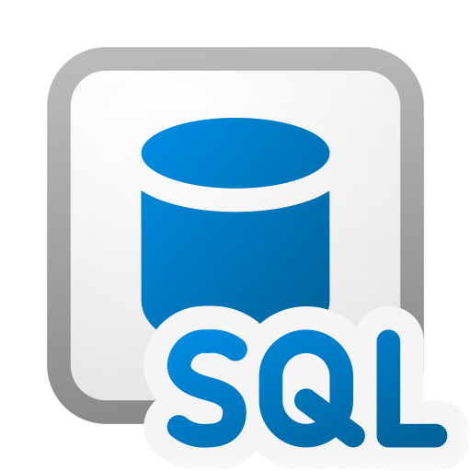
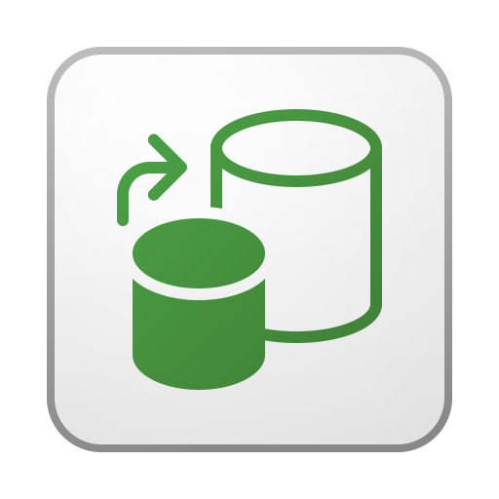




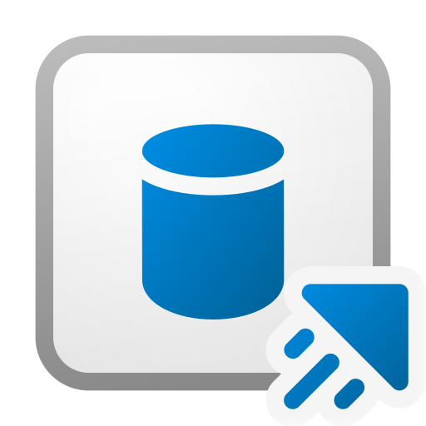











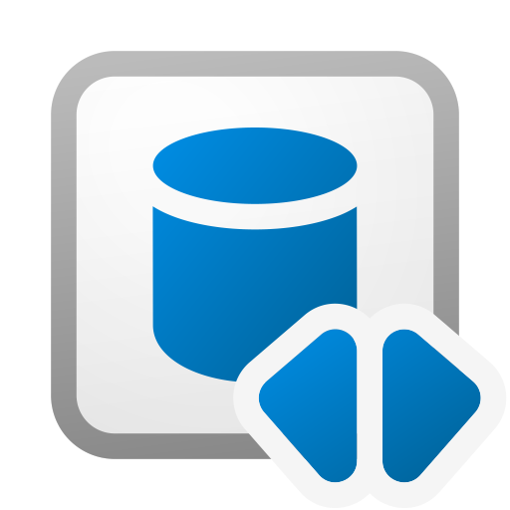



AI Skill
Event Schema
Data Science model
Scorecard
App Development
Event Stream
Notebooks
Semantic Model
Apps
Experiments
Paginated
Spark Job
Copilot
Exploration
Pipeline
SQL Database
Copy Job
Folders
Real Time Dashboard
Streaming Dataflow
Data factory
KQL Database
Real Time
Streaming Semantic
Data warehouse
Lakehouse
Reflex
Workspaces
Database
Shortcuts
Reflex Item
Dataflow Gen2
Metric Sets
Report
Mirrored generic
database
Environments
Schema
Event house
Schema model

Slide 4

Power BI

Slide 5
































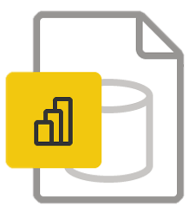








App
DateTime Field
Learn
Calculated Column
Deployment Pipeline
Measure
Calculated Column Numeric
Discover
Measure Group
Calculated Table
Excel Workbook
Numeric Field
Certified
Folder
Paginated Report
Change Detection Measure
Gateway
Parameter
Computed Entity
Geospatial Field
Power Apps
Dataflow
Goals
Power Automate
Data group
Linked Entity
Power BI
Dashboard
Hierarchy
PBI Data source File
Dataset
Identity Field
PBI Desktop
Dataverse
KPI
PBI Desktop Rep Serv

Slide 6
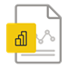



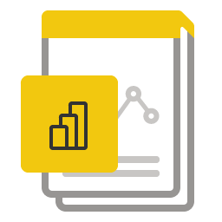

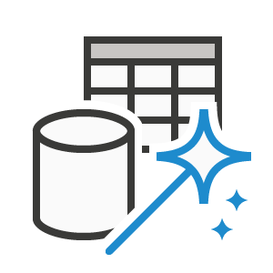









PBIX File
Streaming Dataflow
PBI Report Builder
Warning
PBI Template file PBIT
Workspace
Power Query
Tabular Editor
Power Virtual Agents
Premium
Premium Per User
Promoted
Report
Row-level security (RLS)
GitHub - microsoft/PowerBI-Icons: Icons (PNG and SVG) for Power BI
Streaming Dataset

Slide 7




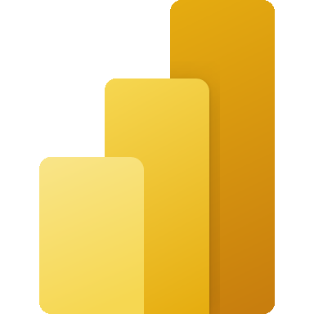




AI Builder
Dataverse
Power Apps
Power Automate
Power BI
Power Fx
Power Pages
Power Platform
Copilot Studio

Slide 8

Security

Slide 9






Public
Highly Confidential
General
Highly Confidential
Protected
Confidential
Non-Business
Confidential
Protected

Slide 10
Office
Microsoft 365 architecture diagram templates and icons | Microsoft Learn

Slide 11
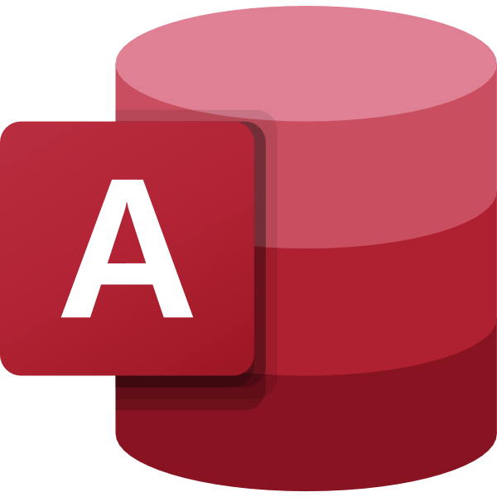
Teams
Access
Excel
SharePoint
Power Point
Word
OneNote
Teams
Power BI
Power Apps
Power Automate
Dataverse
OneDrive

Slide 12
Azure

Slide 13







Azure
Active Directory
Automation
CSV
Key Vault
Stream Analytics
Dedicated Pool
Log Analytics
Dynamics
Datafactory
API
Python
DataLake
Boards
Spark
Databricks
Repos
Kafka
SQL
Pipelines
JSON
Azure Functions
Test Plans
Airflow
Analysis Services
Artifacts
Purview
Database
GitHub
XML
Cosmos DB
PowerShell

Slide 14

Architecture

Slide 15
Security & Governance
Sources
Processing
Semantic
Consumption
Storage
Stream
Data Science / AI

Slide 16
Security & Governance
Sources
ETL
Compute
Semantic
Consumption
Storage
BRZ
SLV
GLD
BRZ
SLV
GLD
BRZ
SLV
GLD
Stream
Adv Wrks DE 0 Prod
Adv Wrks DE 1 Test
Adv Wrks DE 2 Dev
Adv Wks DA 0 Prod
Adv Wks DA 1 Test
Adv Wks DA 2 Dev
Adv Wks ST
Adv Wks DS
Adventure Works
Doman Adv Wrks DE
Doman Adv Wks DA
Doman Adv Wks DS
Resources
Data Science / AI

Slide 17
Security & Governance
Sources
ETL
Compute
Semantic
Consumption
Storage
Domain
Global - GLB
Sales - SLS
HR - HR
Operations - OPS
Marketing MKT
Entra Groups
Fabic_Admin_Build
Fabric_Preview_Build
Stream
Security & Governance
Domain_Function_Build
Domain_Function_Read
Domain_Function_BLD
Domain_Function_RD
Functions
Data Engineering - DE
Data Analytics - DA
Data Science- DS
Data Science / AI

